Slide 1
Introduction to Macros
Lecture 1
Business 4517
Nico

Slide 2
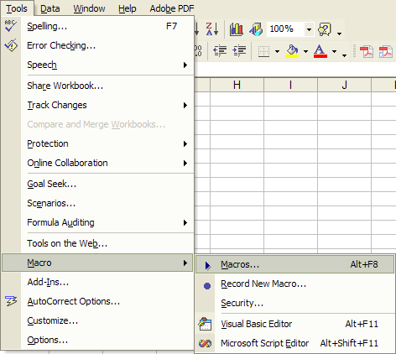
Introduction to Macros
Macros are a very powerful tool that massively extends the functionality and usefulness of Excel
A macro is effectively a small program that is written and runs inside Excel
Macros can use Excel functions and interact with Excel worksheets.

Slide 3
Introduction to Macros
A macro can be created in a few different ways
For now, follow the screenshot on the prior slide
Clicking “Create” will open the VBA editor and create a space to code

Slide 4
Introduction to Macros
The VBA editor:
The VBA environment is surprisingly open and permissive of creativity

Slide 5
Introduction to Macros
Try adding some example code to the VBA code:
Open the macro window again, select the macro, and click Run:

Slide 6
Introduction to Macros
Macros can also be attached to worksheets using VBA controls.
The most common windows controls are available to add to a worksheet
Buttons
Labels
Textboxes
Checkboxes
More...
To open the control box that allows the addition of windows controls, right-click on the toolbar at the top and select “Control Toolbox”

Slide 7
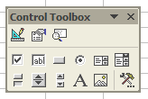
Introduction to Macros
The resulting toolbox contains the available controls:
Once a control is established, double-clicking the control on the worksheet will create an event in code.
Click a control and drag on the worksheet to establish the control.
Right-click the control and select “Properties” to make changes to the control.
These buttons toggle “design mode”, opens a “Properties” window and shows code
In this row we have the toggle, spin, scroll, label, and image controls. There is also a button to add more controls.
In this row we have the checkbox, textbox, button, radio button, list, and combo controls

Slide 8
Introduction to Macros
A number of events can be attached to a given control
In the screenshot above, the default event Click has been created by VBA
The drop-down box along the top of the screen allows the user to peruse all the various events associated with a control

Slide 9
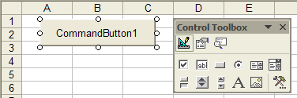
Introduction to Macros
In-class activity:
Try selecting the button control and create a button on a worksheet
Notice that this process is identical to drawing controls on a form in Visual Basic
By default, the button is called CommandButton1 and has the same caption; click “Properties” to modify
Code for the controls resides in the respective worksheet
Currently there are default values associated with this control
Properties

Slide 10
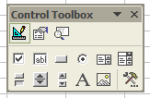
Introduction to Macros
To edit code associated with a control, double-click the control or click the code button on the Control Toolbox
Remember that with controls located in a worksheet, associated code is also in the sheet
Click this button or double- click the control to open the code editor

Slide 11
Introduction to Macros
Traditional forms can be added by right- clicking on the project navigator:
Once a form is added, controls can be created and it can be opened/closed from the Excel worksheet

